Slide 1

Fast food restaurants data Analysis for USA
By
Kapil Gupta

Slide 2
Problem statement
Attraction towards Fast-food is increased all over the world, specially in US.
It creates large demand of fast-food chain restaurant. Here, we will analysis the different fast-food restaurant and their popularity in US.

Slide 3
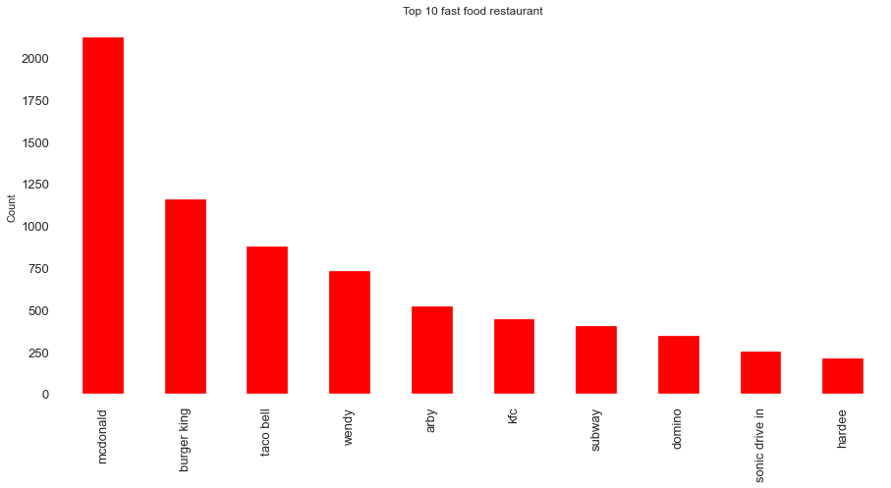
Top 10 fast food restaurant in US

Slide 4
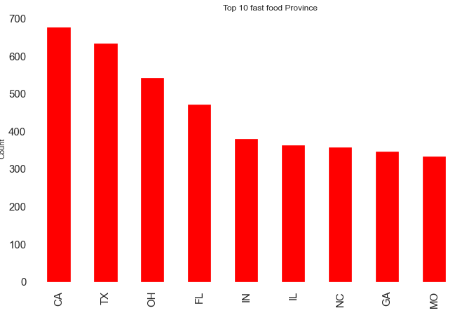
Top 10 province in US with large number of fast-food restaurant
CA California
TX Texas
FL Florida
OH Ohio

Slide 5
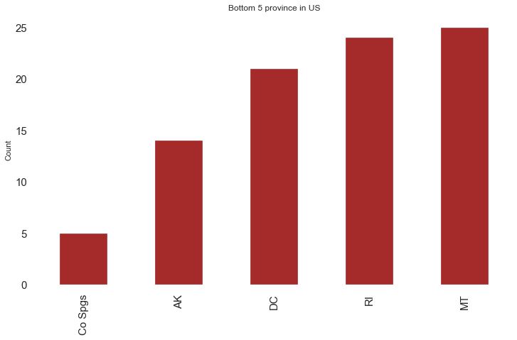
Bottom 5 province in US for fast food restaurant
Co spgs Colorado Springs
AK Alaska
DC District of Columbia
RI Rhode Island
MT Montana

Slide 6
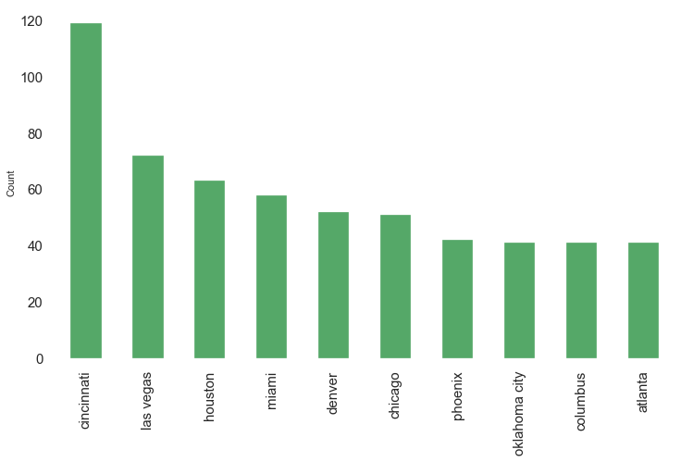
Top 10 city in US
Cincinnati from Ohio PV

Slide 7
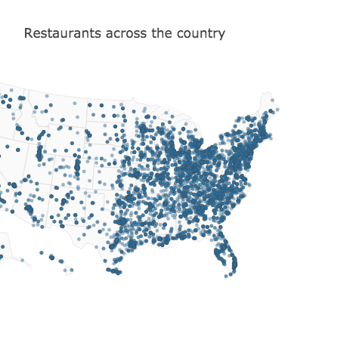
Geo graphical presentation of restaurant in U.S

Slide 8
Analysis for Top 2 fast-food restaurant chain in US
McDonald 2119
Burger King 1154

Slide 9
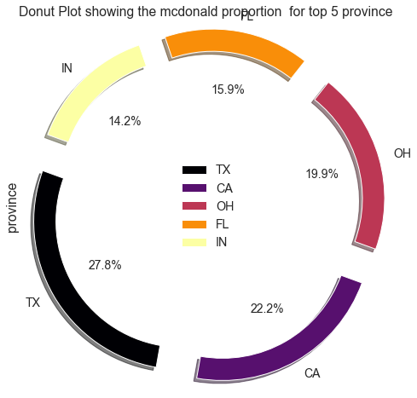
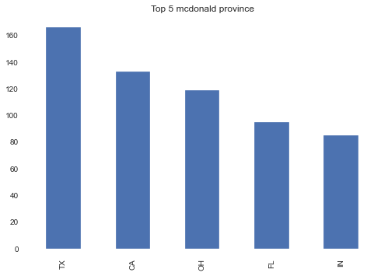
Top 5 MacDonald province

Slide 10
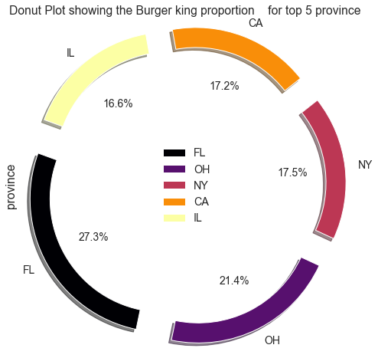
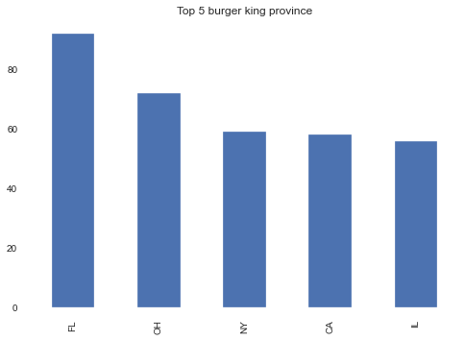
Top 5 Burger King province

Slide 11
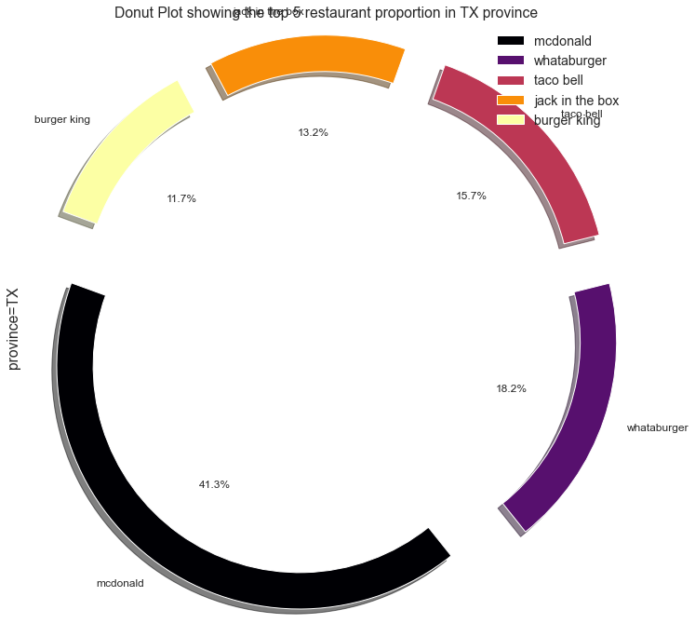
comparison MCD and Burger-king position in TX province

Slide 12
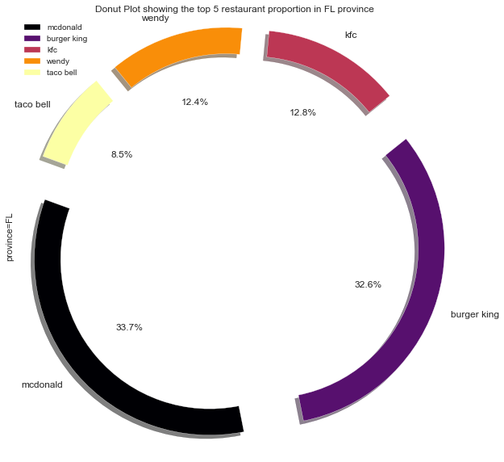
comparison MCD and Burger-king position in FL province

Slide 13
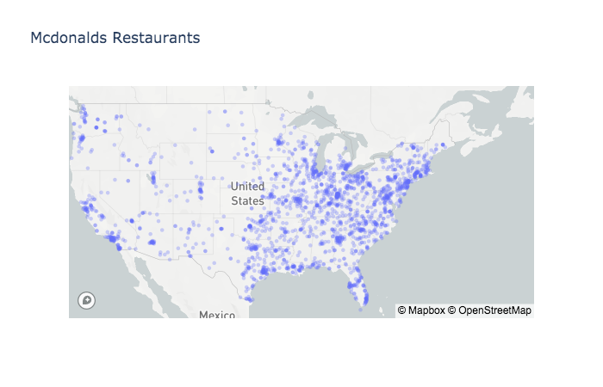
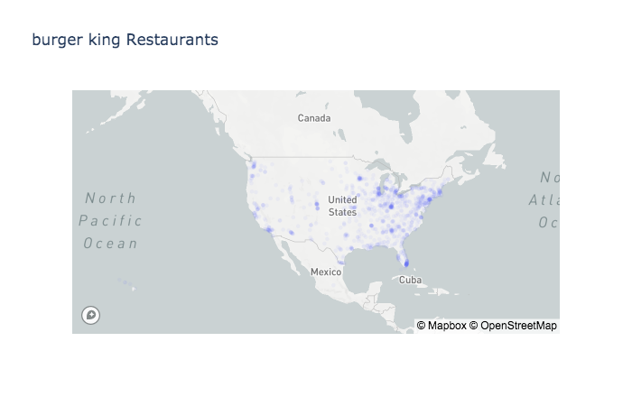
Geo Graphical presentation of MCD and Burger-king restaurant in US

Slide 14
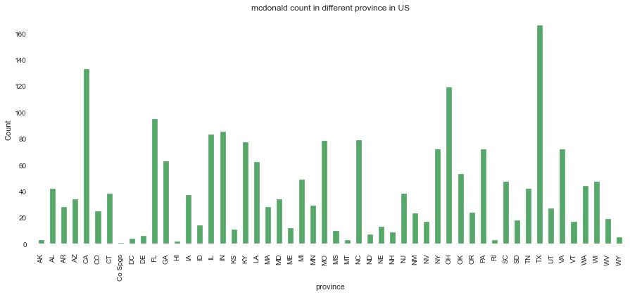
McDonald count in different province in US

Slide 15
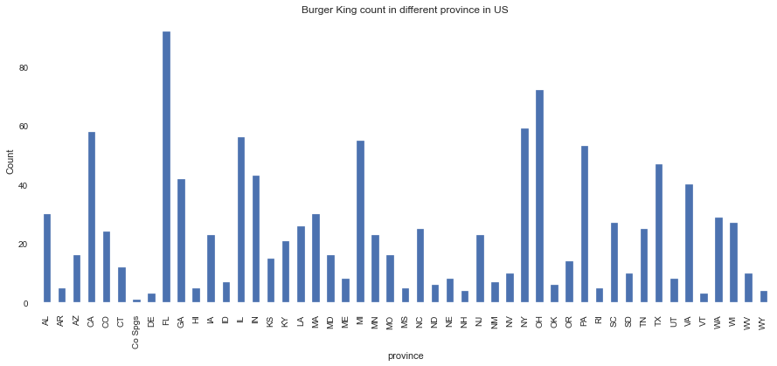
Burger King count in different province in US

Slide 16
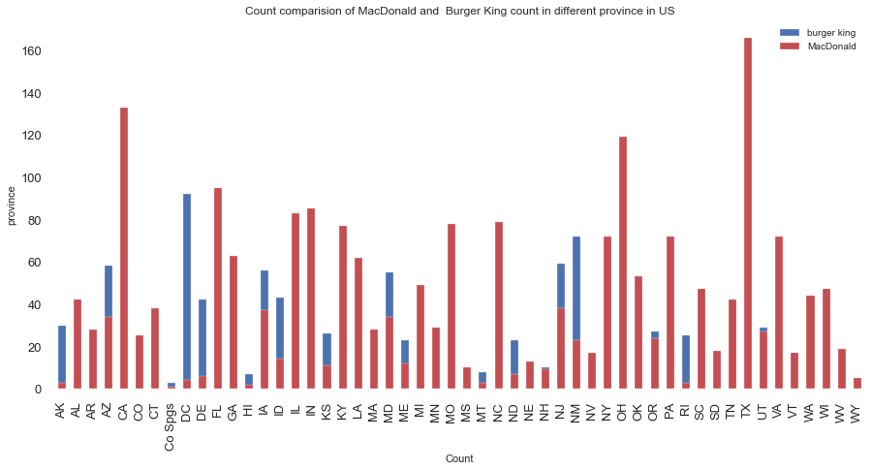
Count comparison of MacDonald and Burger King in different province in US

Slide 17
Conclusion
- US is full of fast food restaurant
- McDonald and Burger King are 2 most popular fast food brands in US and popularity of burger is more than other fast food in US.

Slide 18

Actionable insights
- Two Burger brands are topmost in count. means Burger are more famous than other fast-food items in US
- McDonald is number one fast food chain in US. However, Burger king going to give good competition in some province like FL.
- City Cincinnati have maximum fast food restaurant in US.
- Province TX and CA have maximum restaurant in US
- in TX province, Mcdonald is one number one and Burger king is at number 5 position
- in FL Burger king and MacDonald have approx same density
- CO spg(Colorado Springs) and AK are Bottom 2 Province in fast food restaurant
- McDonald have higer density of restaurant TX, CA and OH Province
- BurgerKing have higer density of restaurant FL, OH and NY Province

